Slide 1
SPEED LIMIT CONTROL WITH VOICE COMMENTS
Traffic sign and speed limit recognition and control with voice comments
Team Members:
1.Sunil Krishna PJ
2.Sai Siddharth P
3.Rawin Prakash S

Slide 2
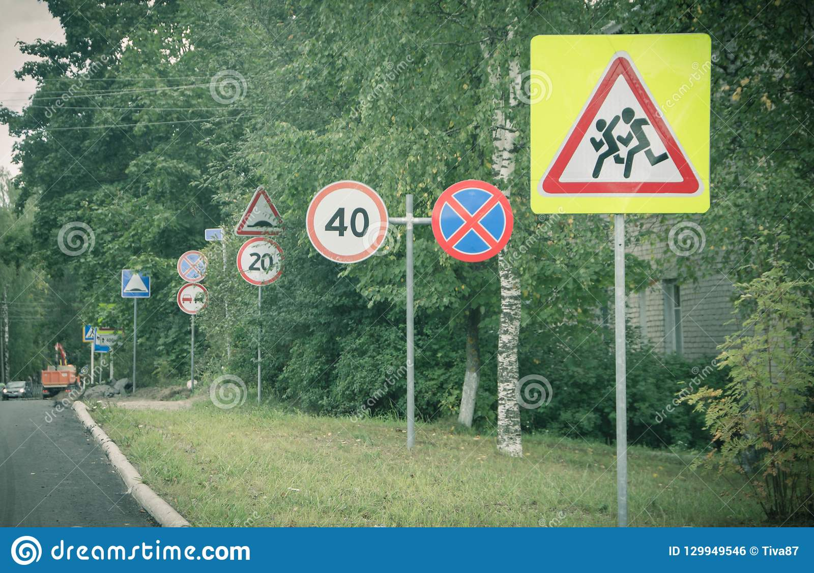
Traffic sign and speed limit recognition
# This project is on the topic given above.
# This is used in two wheelers for recognizing the traffic sign and speed limit board in the roads and highways and gives a voice comment to reduce the speed if needed by after recognizing the signs and speed limits.
# This will also tells if there any police speed limit cameras before them and will notify the driver.

Slide 3
PROBLEM:
# Many of us , while driving the two wheeler ,we wont see the speed limit boards and traffic signs .
# So many has to pay the fine for speeding and many accidents do occurs , and it affects the public a lot.
# Many cautious people will see the sign board and control the speed but they do may able to met with accident by not seeing the road and searching for the speed limit boards.

Slide 4
OBJECTIVE
# So we are here with the project , that will recognize the traffic signs and speed limit boards in the road side and gives the voice comments to reduce the speed if needed .
# This will also notify if any traffic speed limit cameras are in the front of them and assist to reduce the speed.
# By this the many accidents will not occur and paying of fine to police will be reduced .

Slide 5
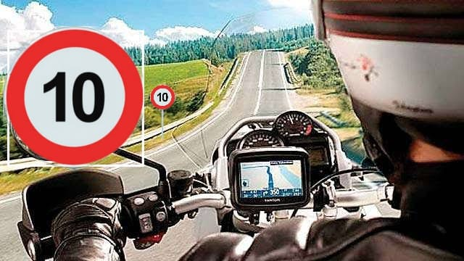
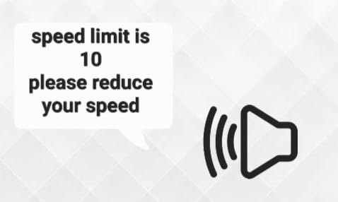
WORKING
# A camera will be fixed in the front of the two wheeler .
# Then the camera will detect the traffic signs and speed limit boards in the road side and will give the voice comments .
# The voice comment will guide them to reduce the speed if needed.

Slide 6


TOOLS USED
# Our project done with python mainly with help of cv2 package.
#Machine learning is used to train the images to the code.
#With the help of webcam the image will be verified and will be showing the sign name

Slide 7
THANK YOU

